Slide 1

INFO 6150 - Final Project Submission
Well Eat: Know before you eat
A journey through our development process, focusing on creating a healthy and user-friendly experience.
Team - HonoredOnes

Slide 2
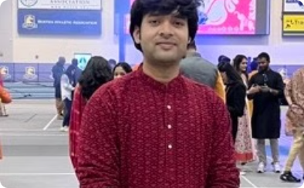


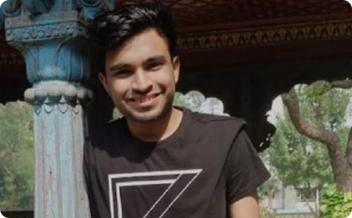
The HonoredOnes Team
Prayas Lashkari
Amritesh Anand
Hritik Hassani
Shubham Bhadra
Designer, Developer with a passion for creating beautiful and functional user experiences.
Experienced Fullstack developer with a passion for building scalable and performant web applications.
Developer and Entrepreneur with a focus on building products that solve real-world problems.
Experience Backend Developer and Data Engineer with a focus on building scalable and reliable backend systems.

Slide 3





Tech Stack Overview
React & TypeScript
PWA Capabilities
Internationalization
Component & Unit Testing
Core frontend technologies for robust development
Enabling offline functionality and app-like experience
Supporting English, Chinese, Tamil & Hindi languages
Storybook for Component Development, Jest and React Testing Library for unit testing

Slide 4
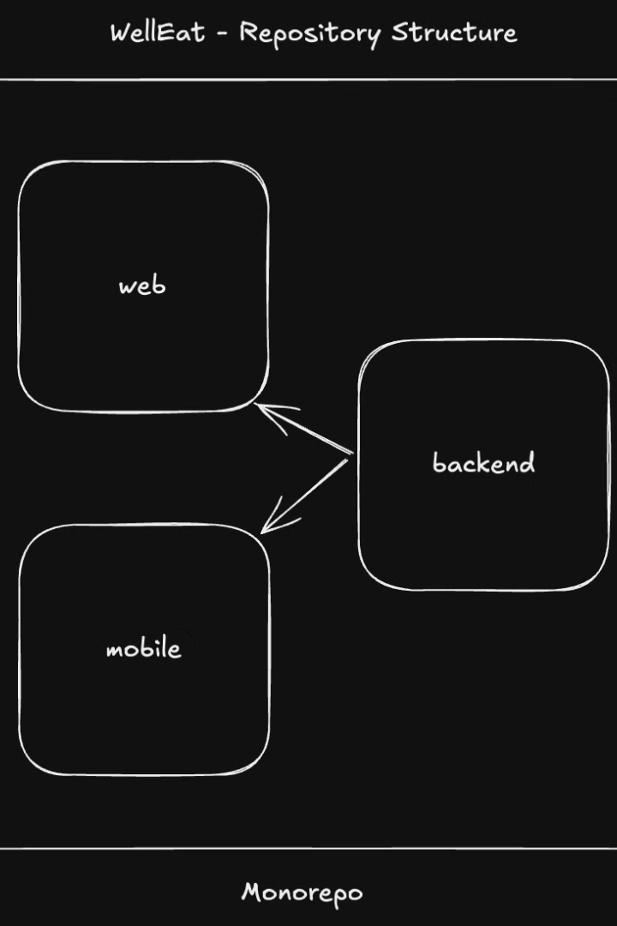
Project Structure
1
Yarn Workspaces
2
Monorepo Architecture
Efficient package management and dependency sharing
Packages: frontend, backend, and mobile

Slide 5
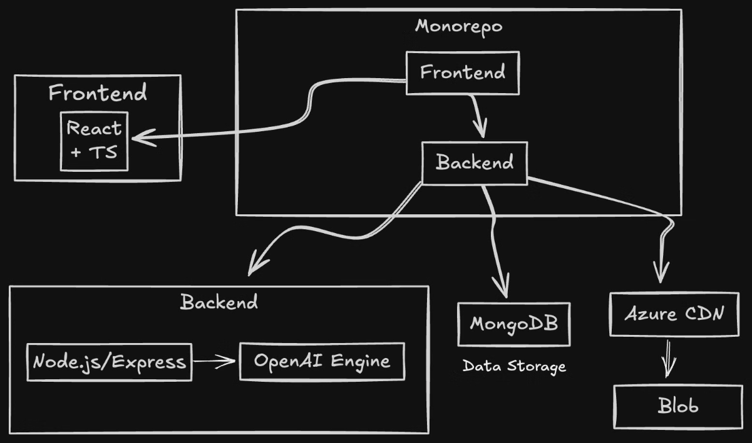
Architecture
Frontend
Backend
Mobile (future)
React, TypeScript, Vite for rapid development
API development, database management, server-side logic
Cross-platform mobile app development

Slide 6

Demo
Live Demo
Learnings
Showcasing key features and user flow
PWA App Fugu Capabilities
Future Improvements
Planned enhancements and feature additions

Slide 7



Development Challenges
Time Constraints
1
Balancing feature completion with deadlines
Git Workflow
2
Managing merge conflicts and coordinating team efforts
Feature Prioritization
3
Deciding on critical vs. nice-to-have features

Slide 8

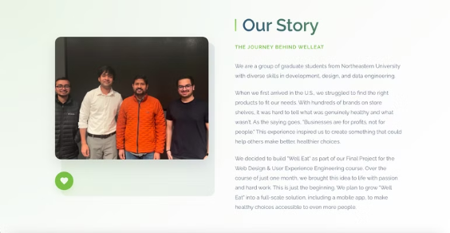
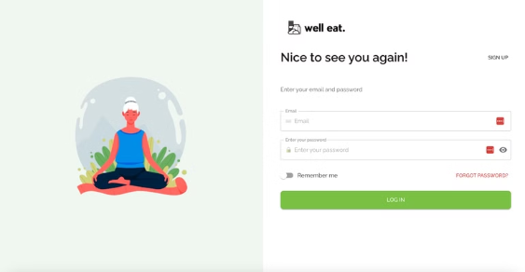
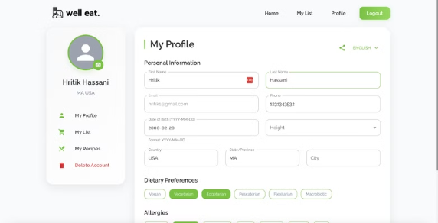
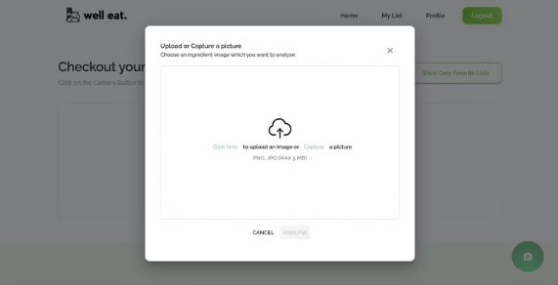
Project Screens

Slide 9
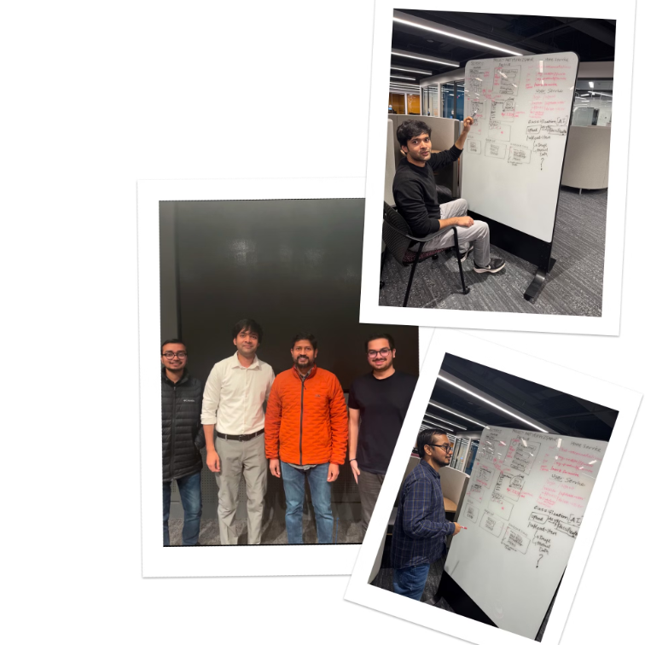
Thank You

